Slide 1
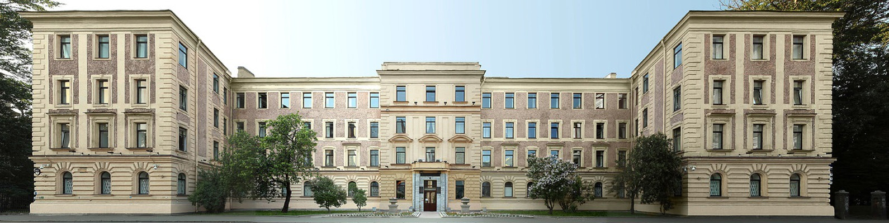
Pavlov University

Slide 2
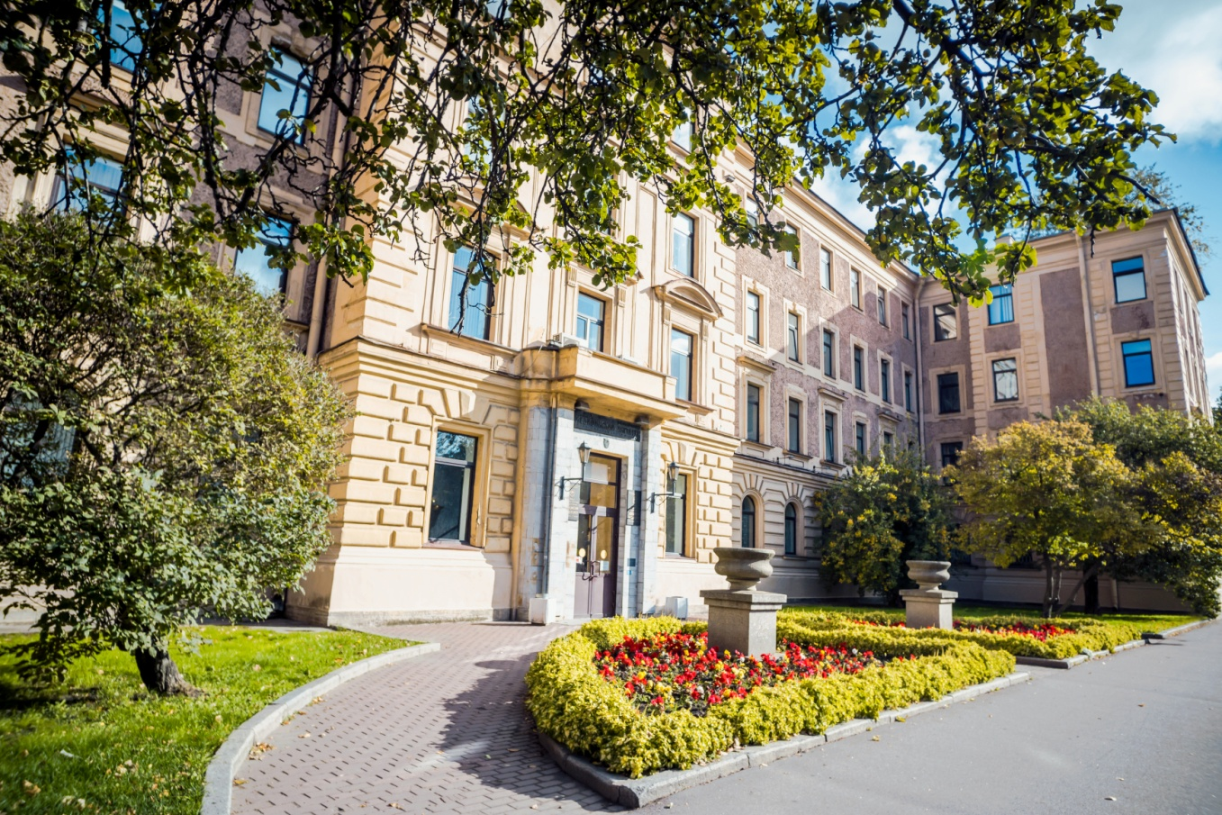
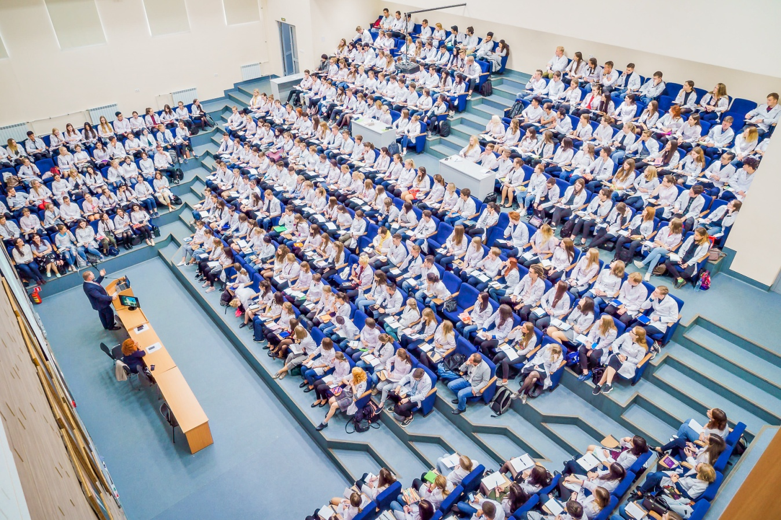
Pavlov University

Slide 3
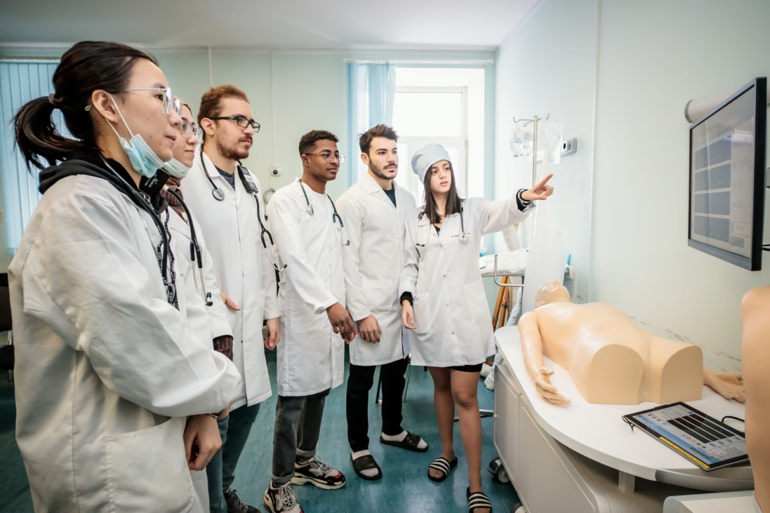
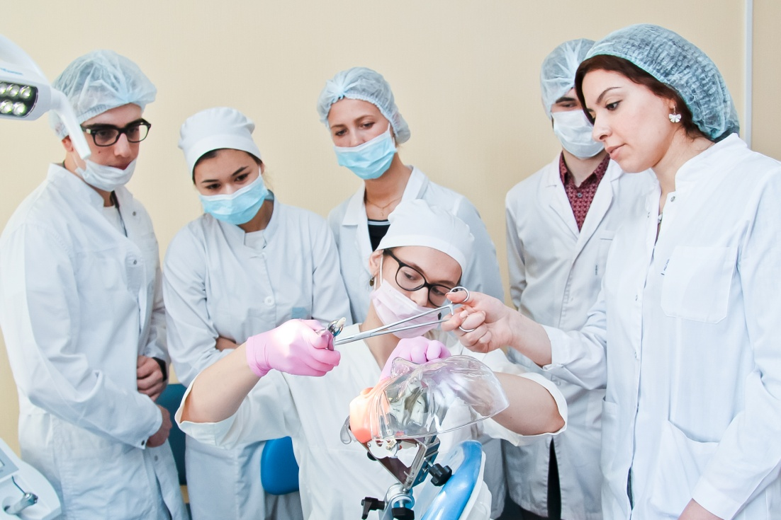
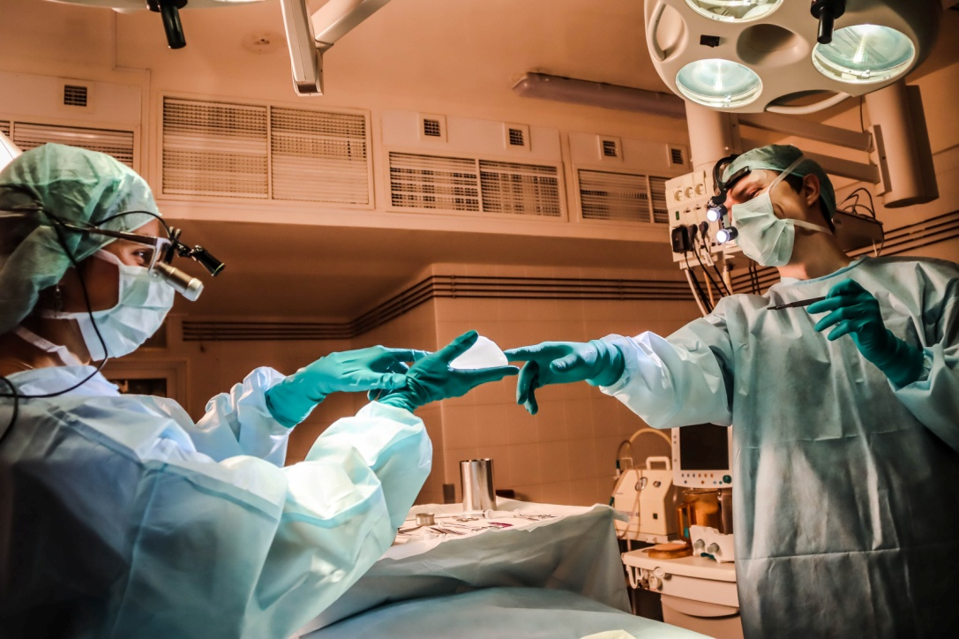
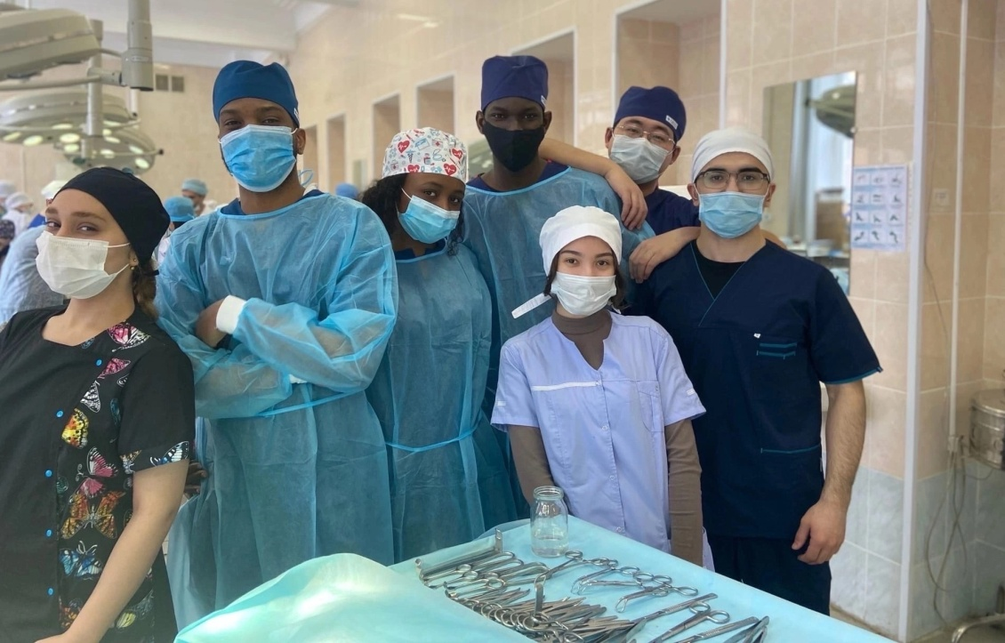

Slide 4

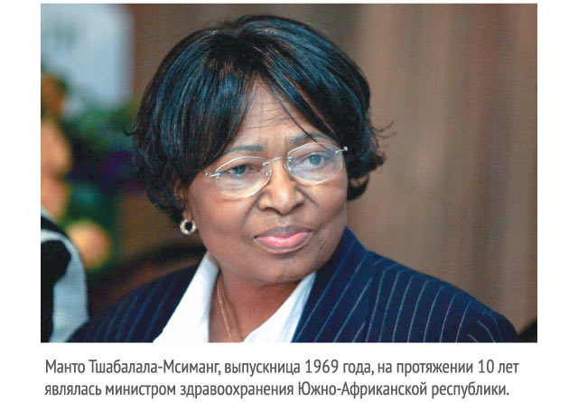
Medical faculty____ of international students___
Our University is rated as one of the 5 top medical schools in Russia.
We are also included in the ranking of the best universities
in the world by the British company
Quacquarelli Symonds (QS) QS World University Rankings.
Our University is proud to have many successful international
alumni, who are holding senior positions at the State,
and National levels in their countries.

Slide 5
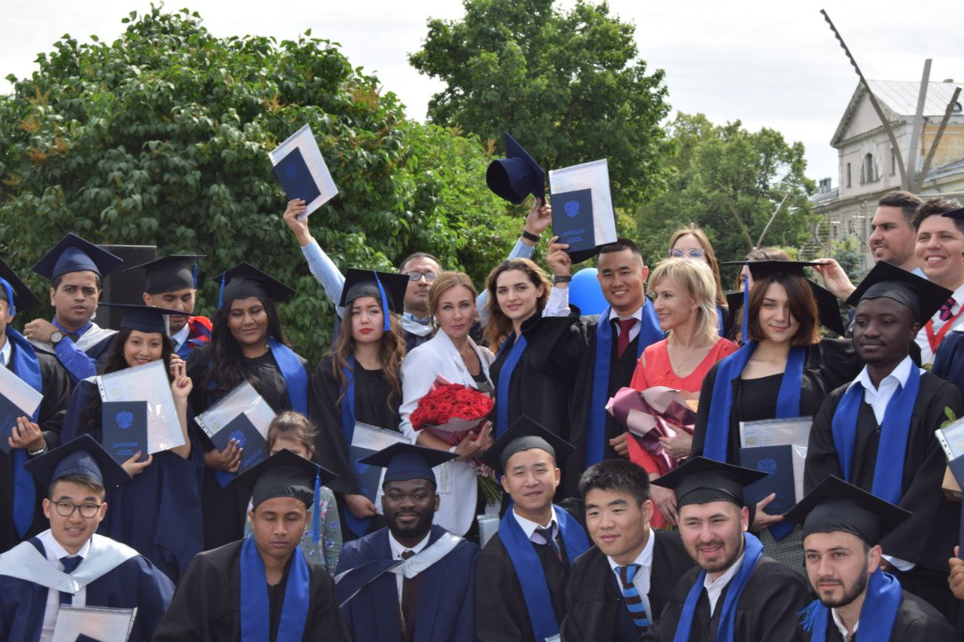
Medical faculty____ of international students___
The first foreign students - at the beginning of the 20th century
In the 60s, the Faculty of International Students was established
The university's graduates include citizens from Asia
and Africa, the United States and Latin America,
Europe and other countries.
Pre-university training: with entry into Russia and remotely
Specialty (General medicine, Dentistry, Pediatrics)
Postgraduate programs

Slide 6
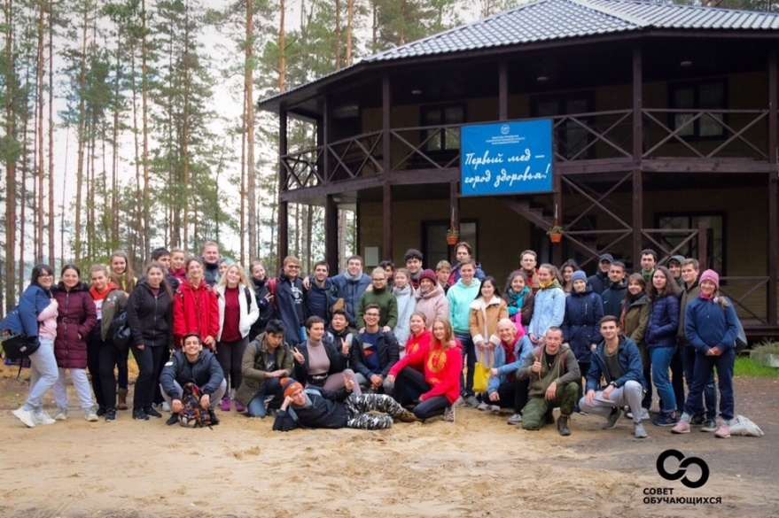
Medical faculty____ of international students____
The faculty provides support to students:
in matters related to accommodation
in a hostel/dormitory
compliance of the legal staying in Russia
(VISA department)
organization of leisure and extracurricular activities

Slide 7
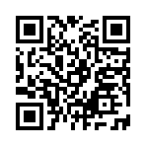
Pre-Entrance Program Department
预科部
Pre-Entrance Program with enter for study to Russia
俄罗斯联邦政府奖学金预科系招生公告
Rossotrudnichestvo scholarship - 20 study places 俄罗斯联邦奖学金名额-20
https://rs.gov.ru/
120 contract’s study places 自费名额-120
Admission: June 1- July 29 (online registration and acceptance
of documents through the Applicant's personal account)
招生：6月1号-7月29日（通过个人账户进行在线注册和提交）
https://abit.1spbgmu.ru/foreigners/

Slide 8
Pre-Entrance Program Department
预科部
Educational program for preparation for entrance exams
预科系入学考试课程说明
Russian language, which is required for admission, study and subsequent communication with patients
俄语课程-入学考试内容以及临床医患沟通（含3-6个学习模块）
Chemistry 化学
Biology 生物
Students receive a certificate upon completion of the preparatory stage
结业认证

Slide 9
Pre-Entrance Program Department
预科部
Pre-Entrance Program in distance format
线上预科系招生公告
Сontract’s study places 自费学习
Admission: October 1- November 30 (online registration and
acceptance of documents through the Applicant's personal account)
招生：10月1日-11月30日（通过申个人账户在线申请及材料提交）
https://abit.1spbgmu.ru/foreigners/

Slide 10
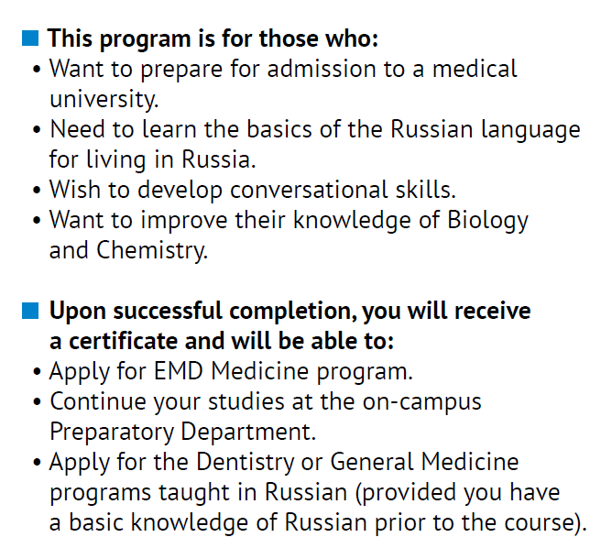
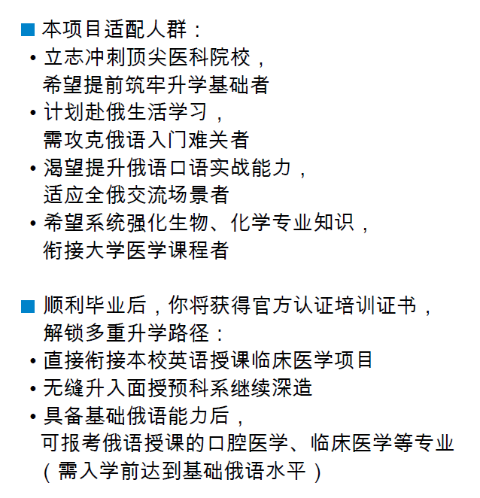
Pre-Entrance Program Department
预科部

Slide 11
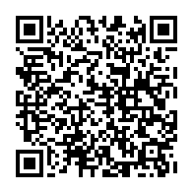
Pre-Entrance Program Department
预科部
Official Pre-entrance Program Admission website information
预科系官方招生信息网
https://abit.1spbgmu.ru/dovuzovskoe-obrazovanie/podgotovitelnoe-otdelenie-dlya-inostrannih-grajdan
Contacts|联系方式:
E-mail|电子邮件: prepspbgmu@yandex.ru
Phone|电话: +79312378086 (WhatsApp, Max)

Slide 12
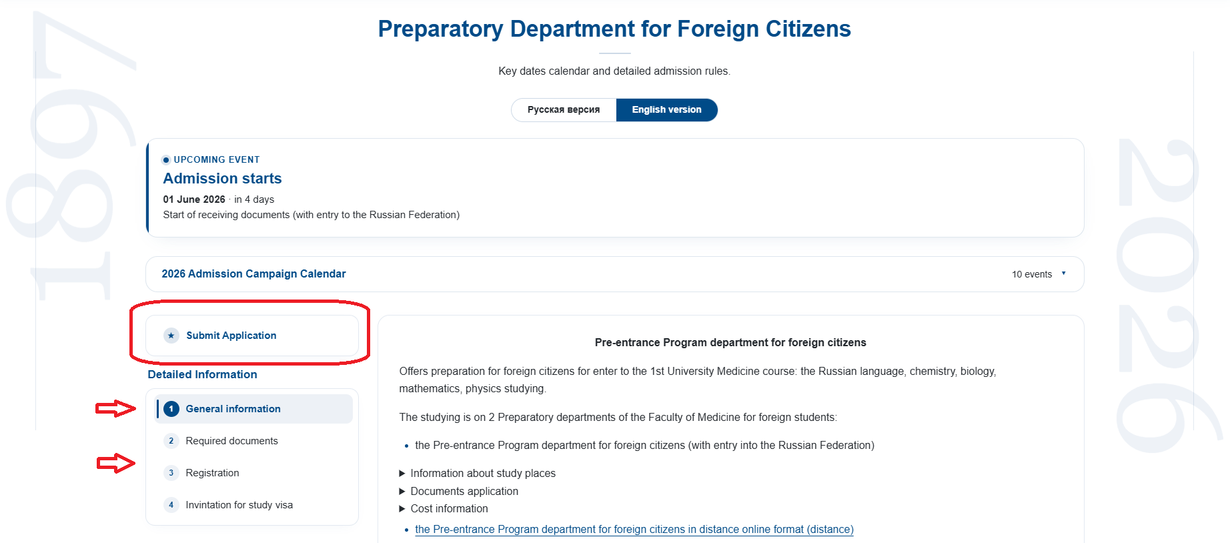

Slide 13
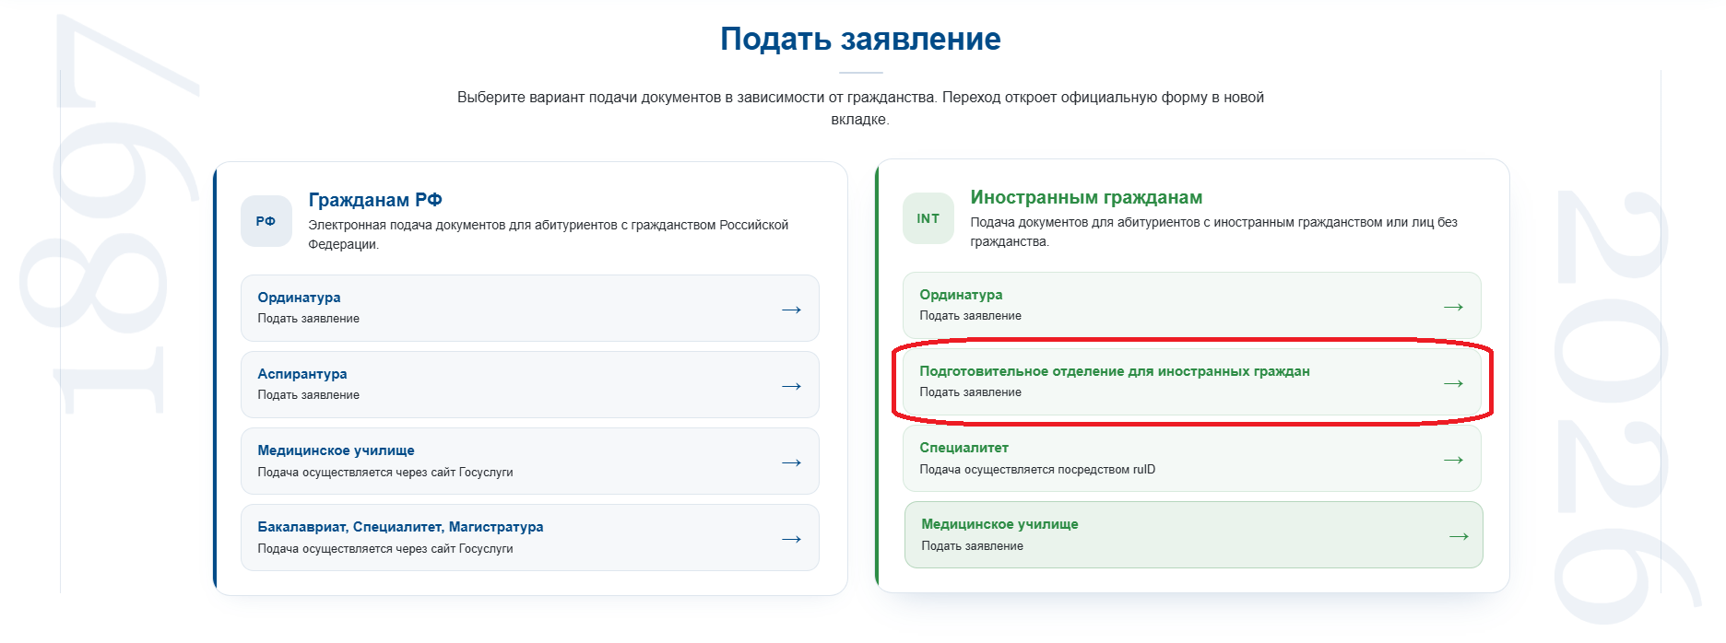

Slide 14

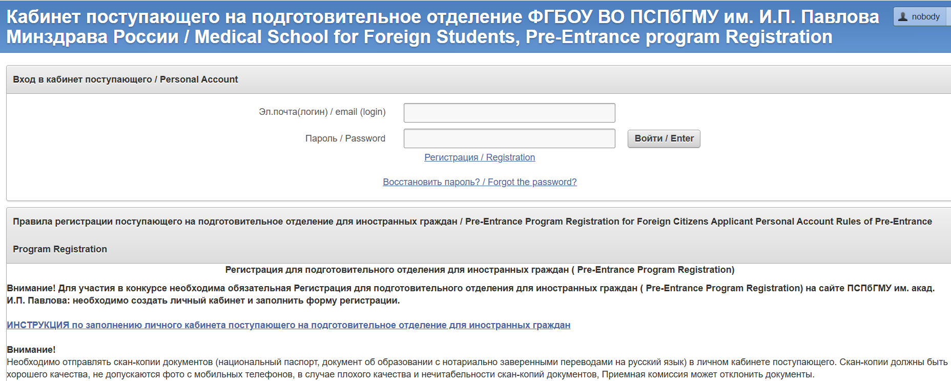
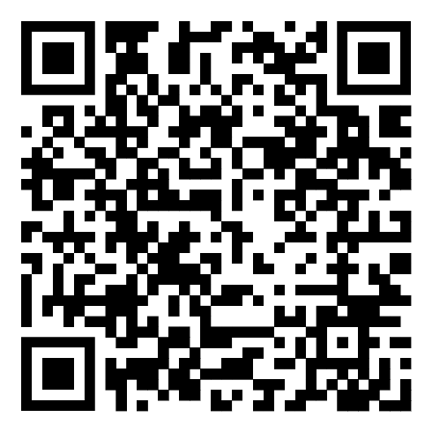
Registration 注册

Slide 15
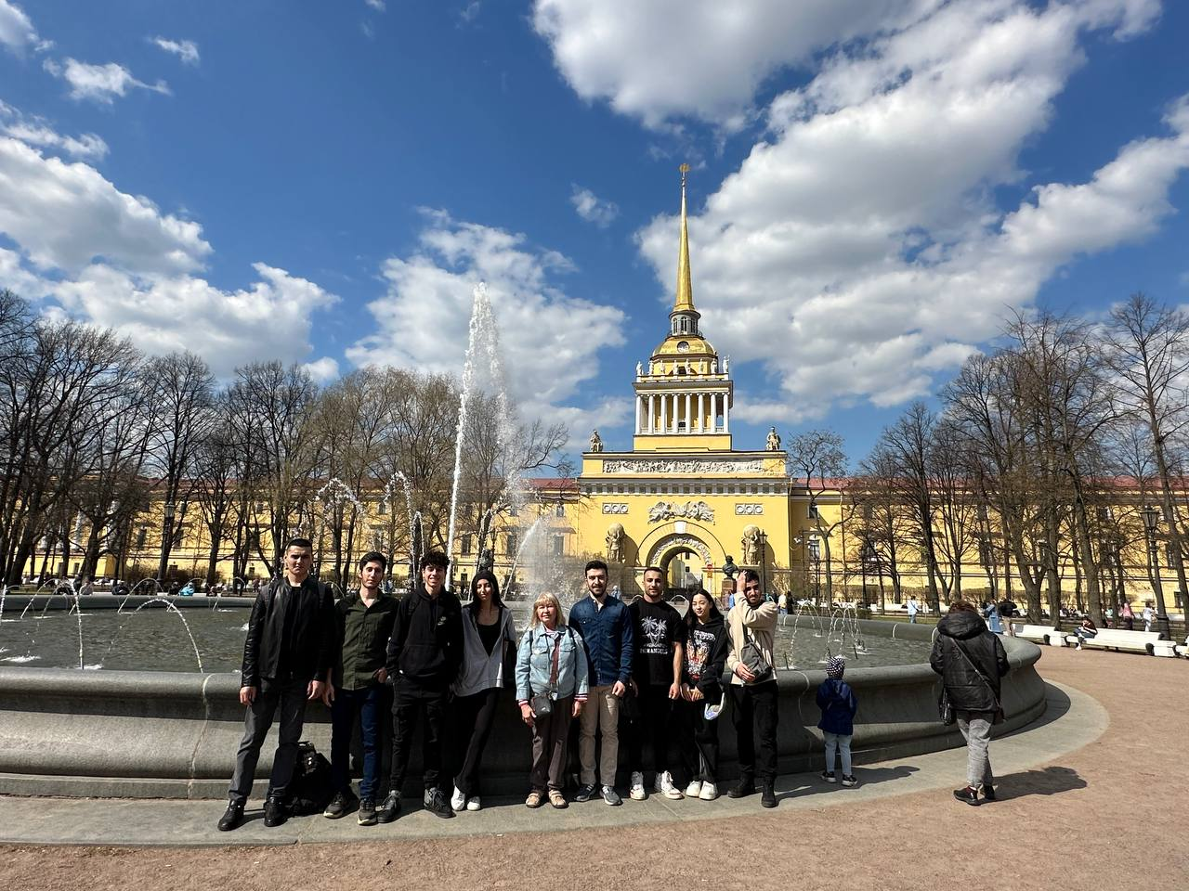
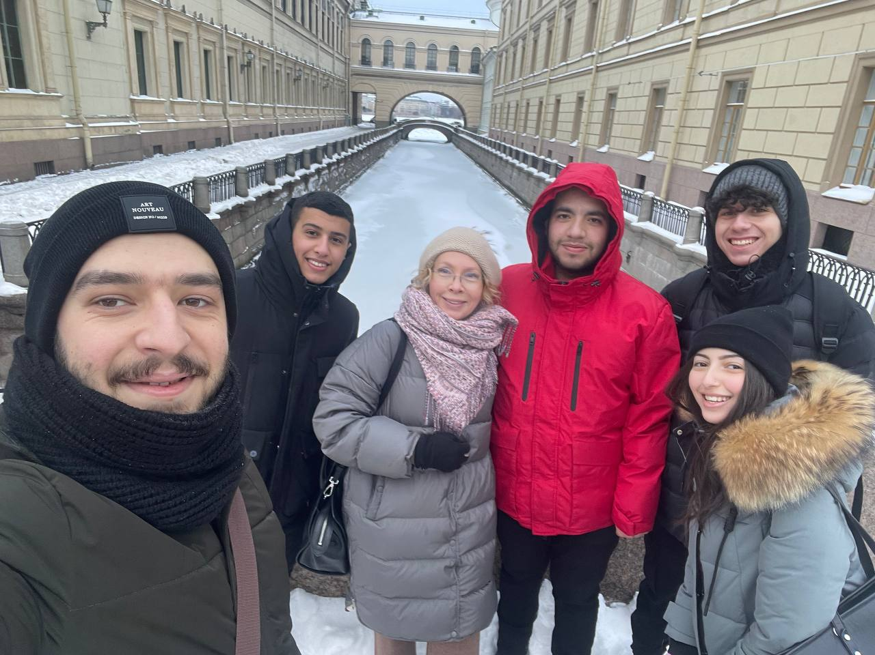
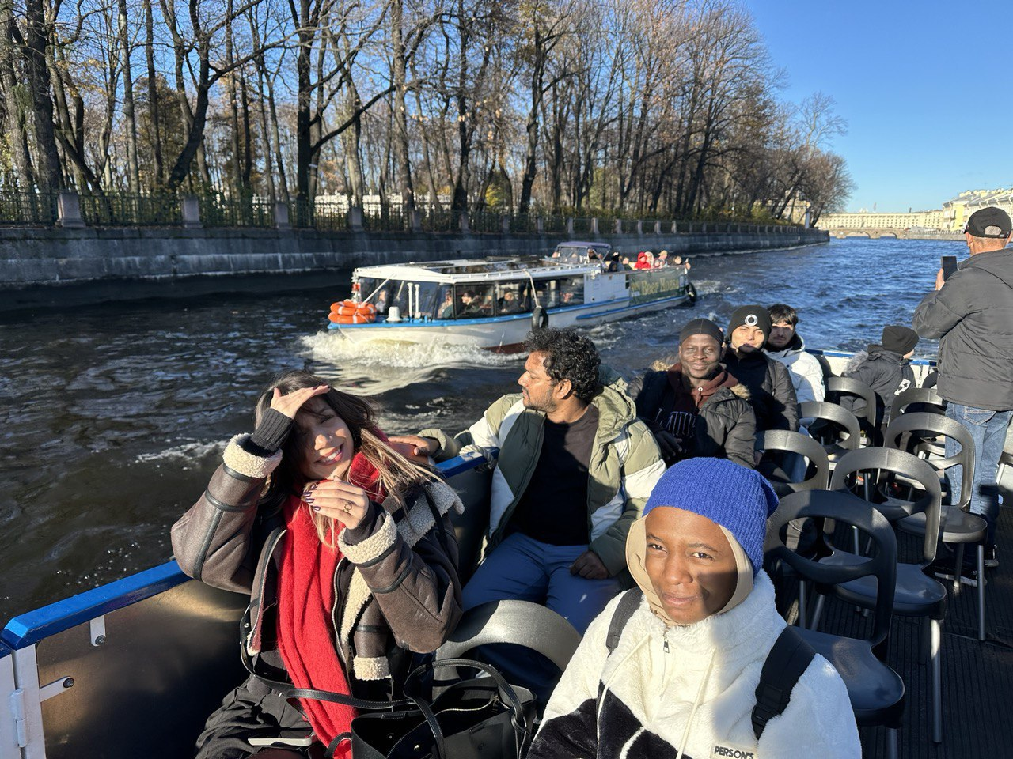
Walks around St. Petersburg
圣彼得堡街巷漫游

Slide 16
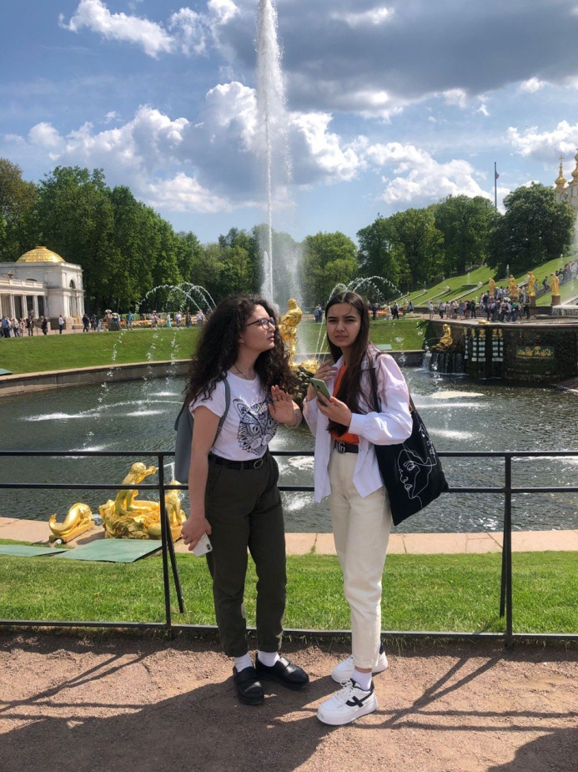
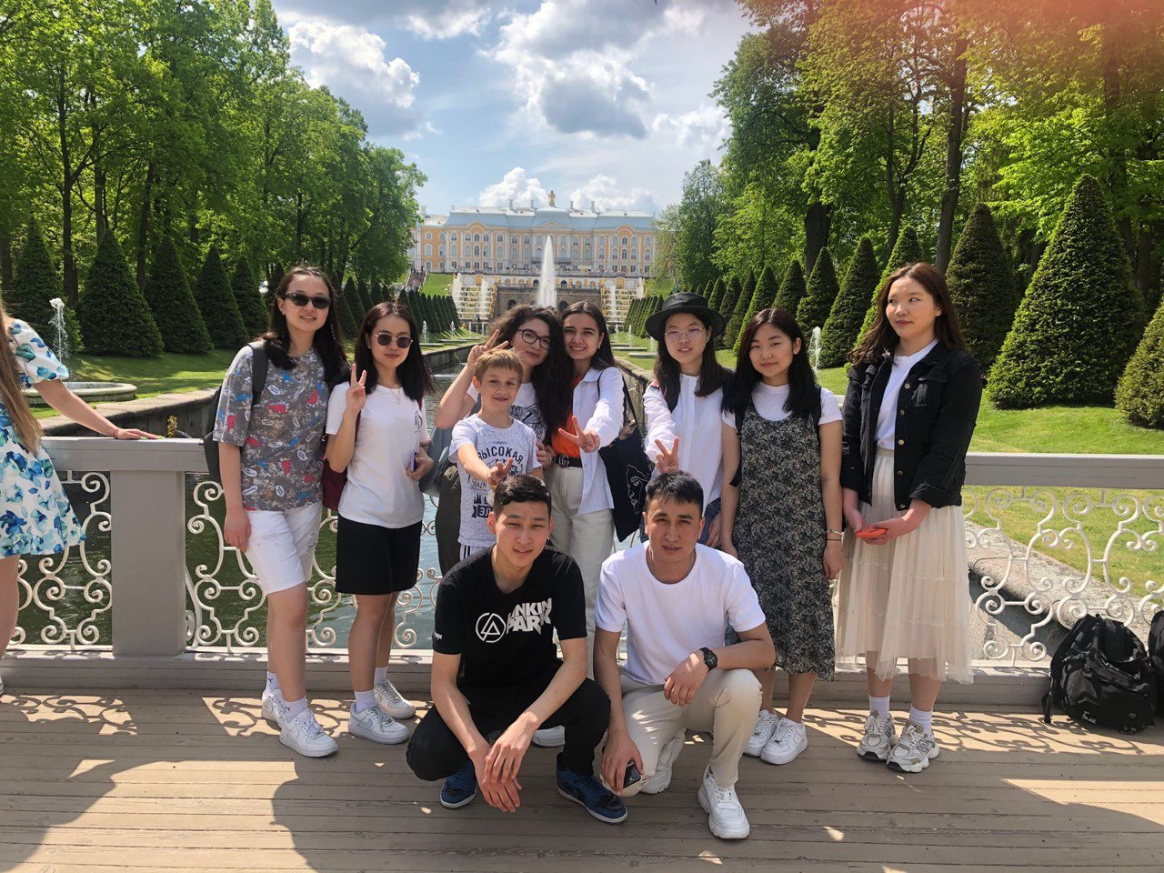
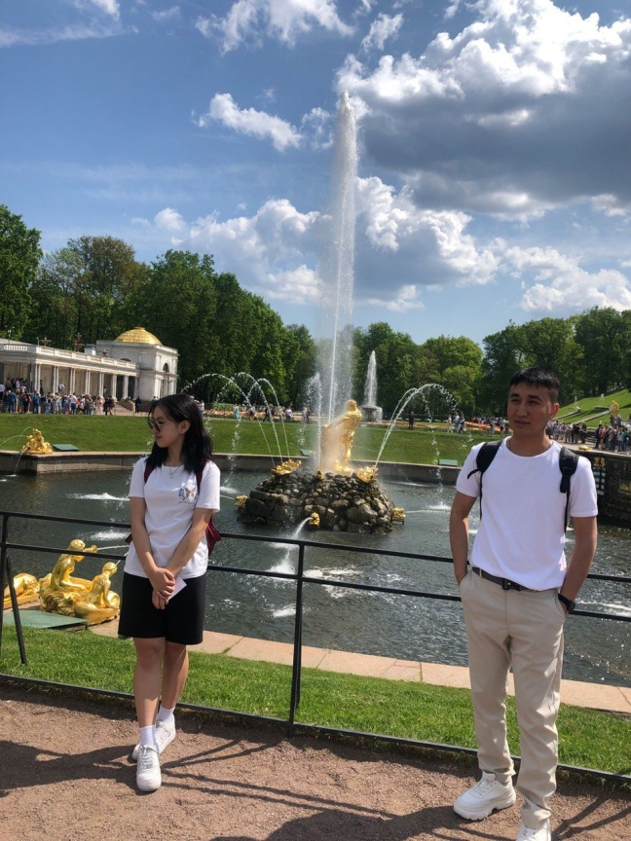
The trip to Peterhof|夏宫

Slide 17
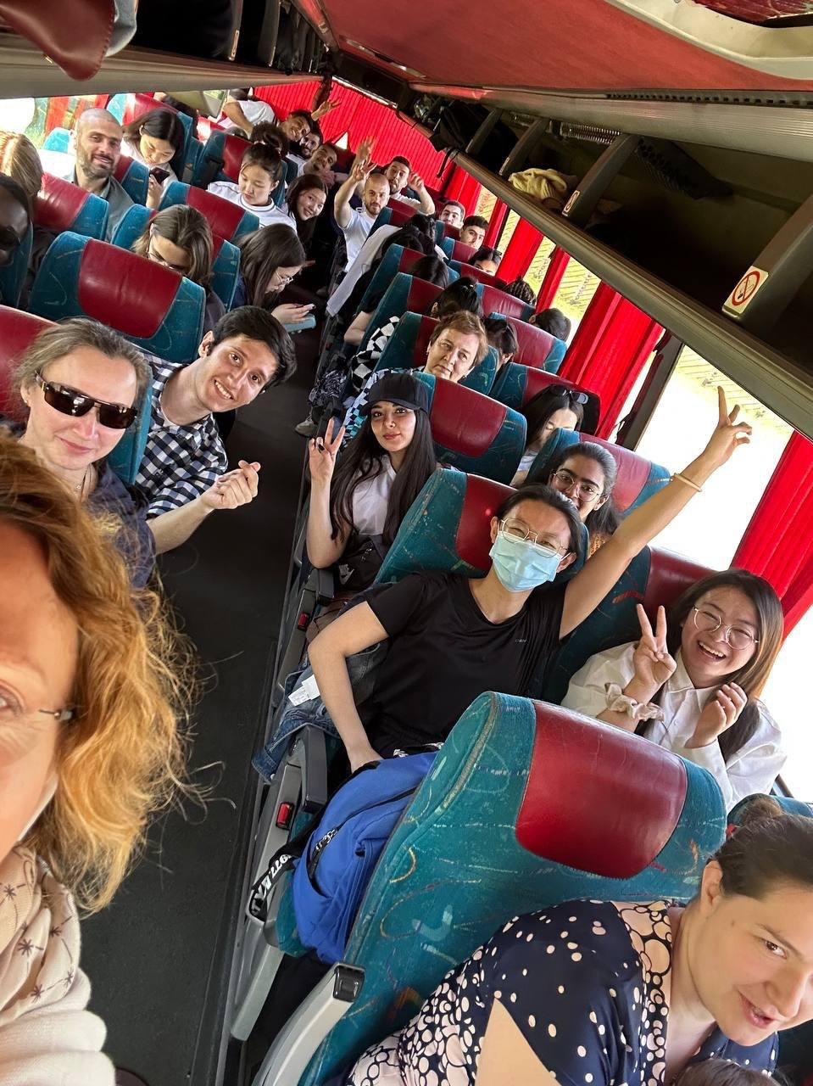

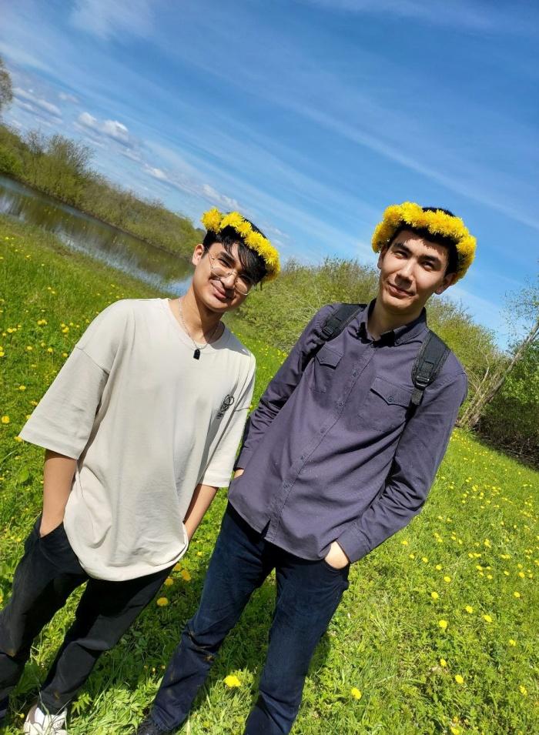
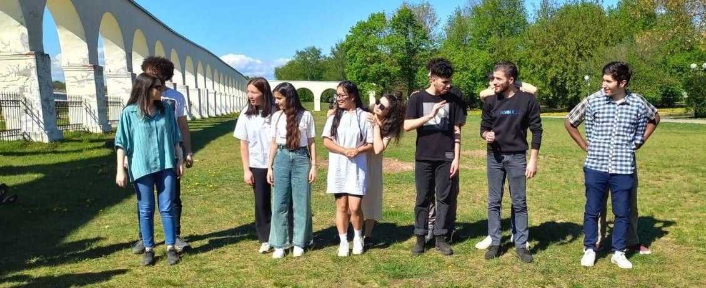
The journey to Veliky Novgorod 诺夫哥罗德

Slide 18
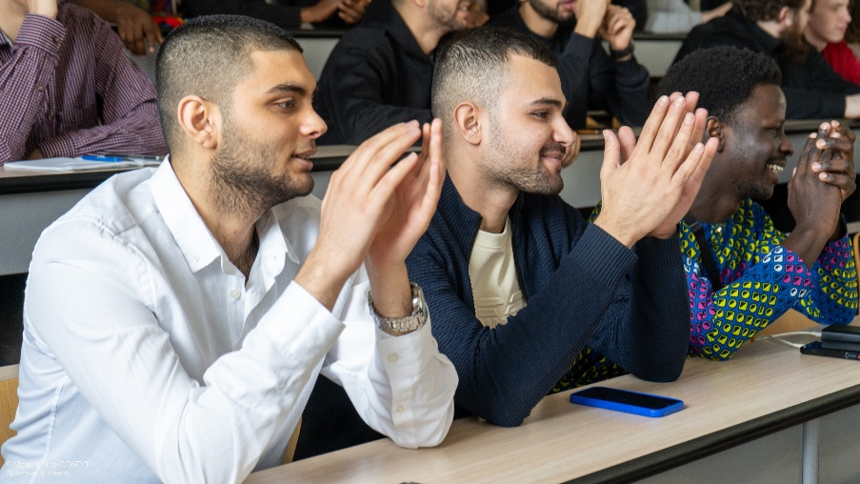
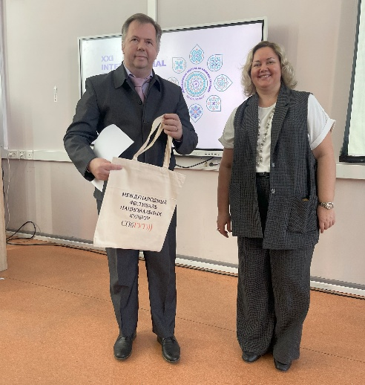
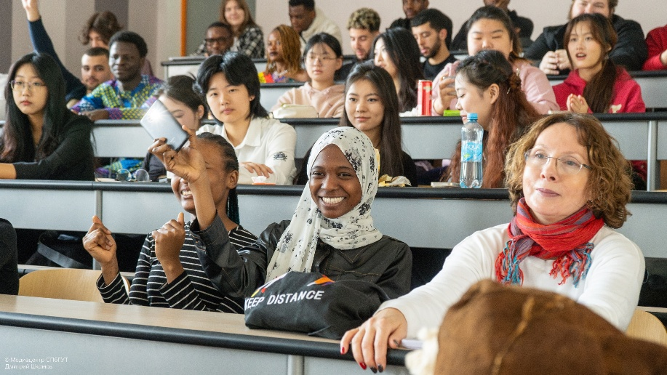
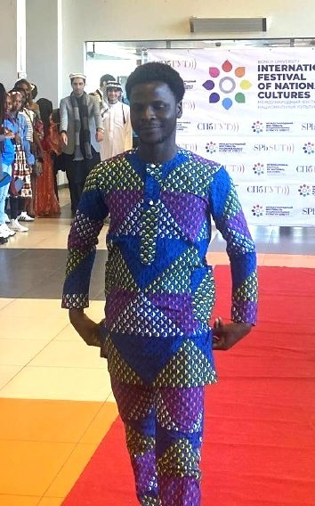
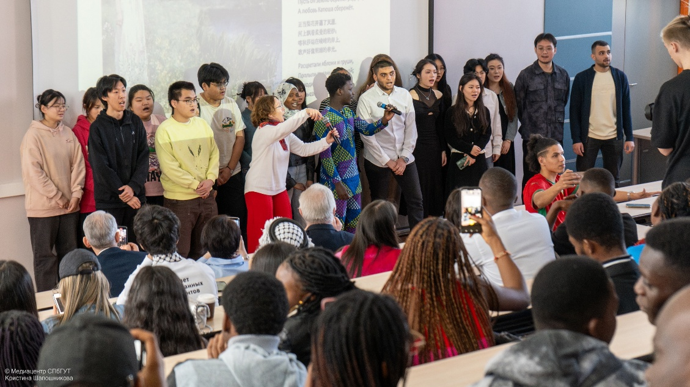
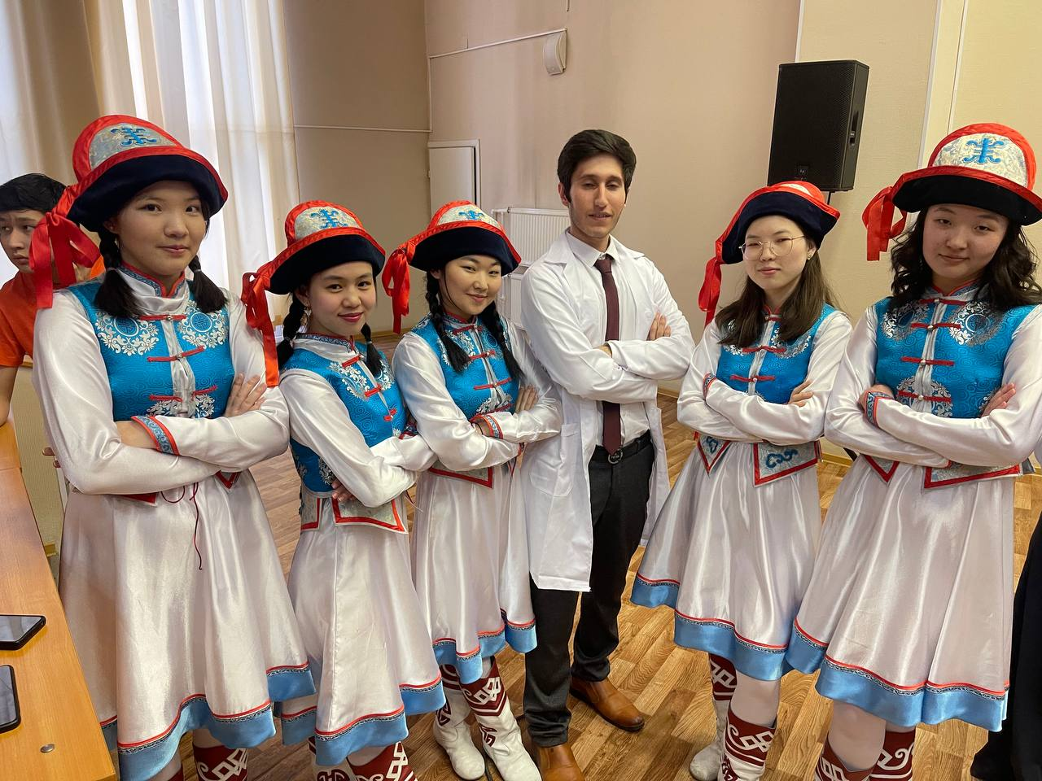
Concerts and festivals 音乐会与庆典

Slide 19
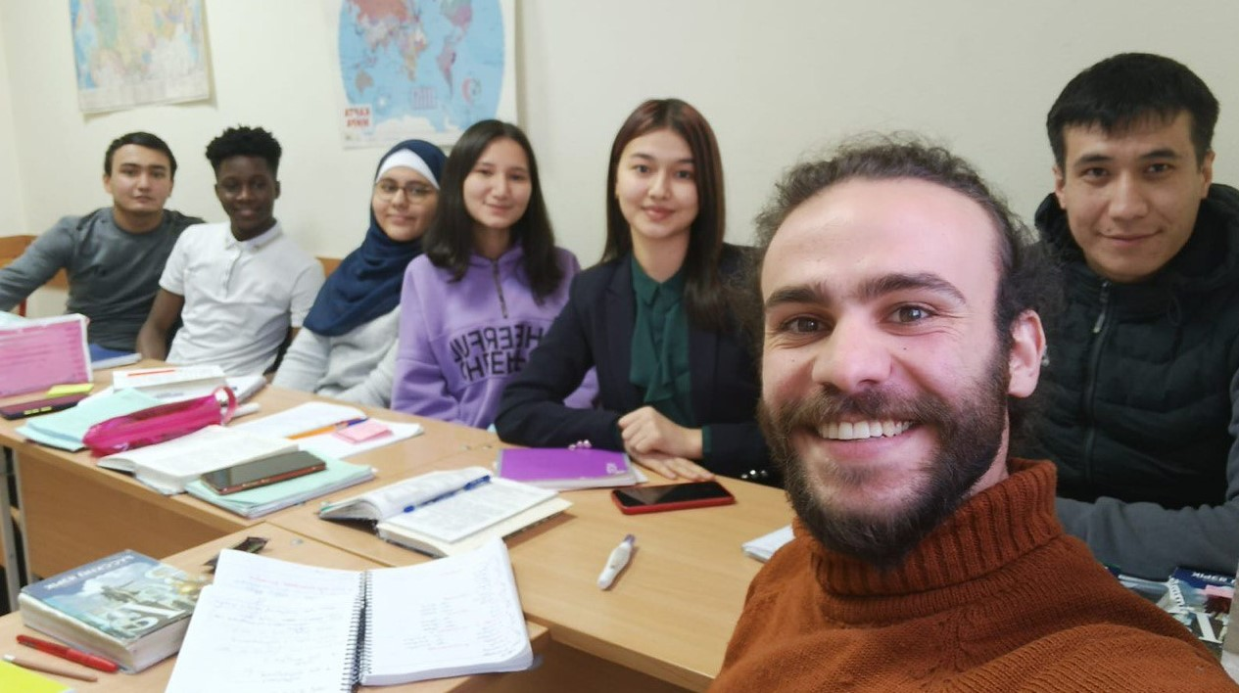
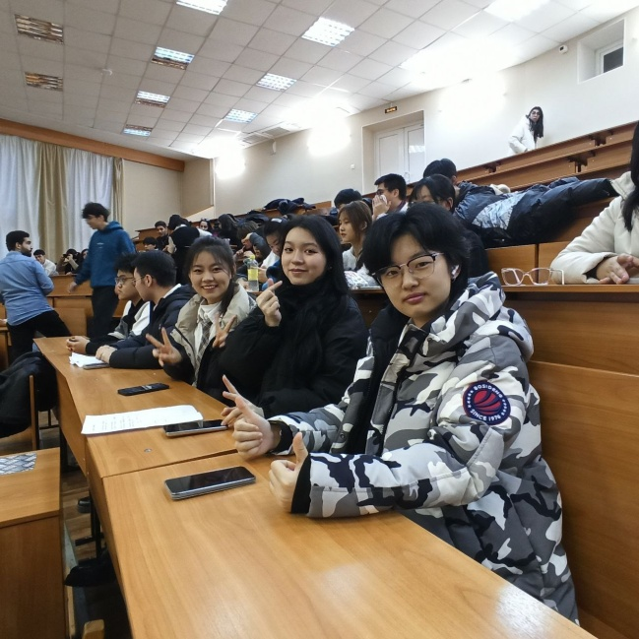
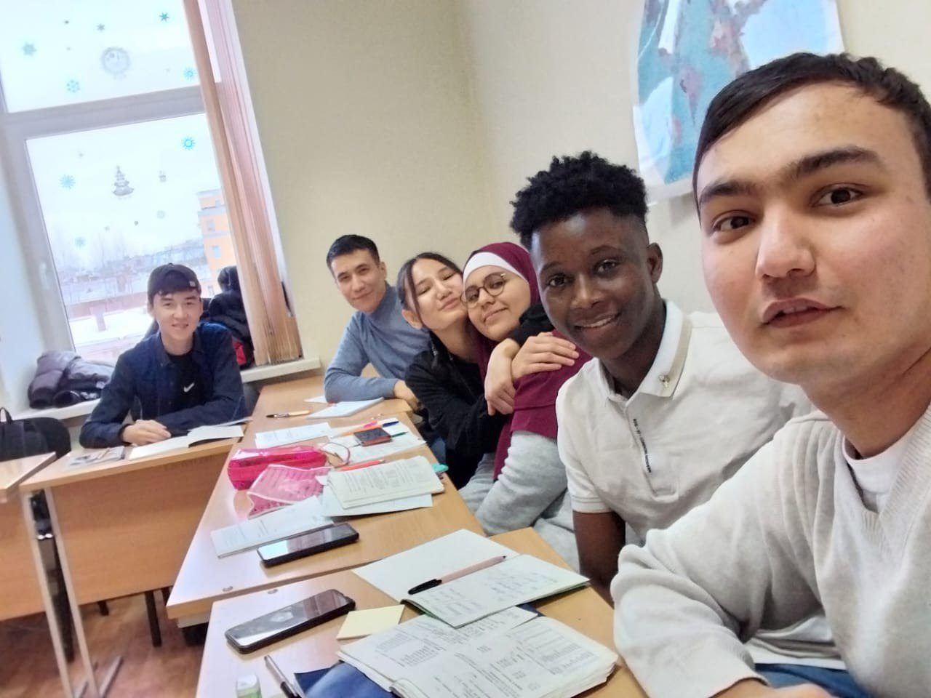
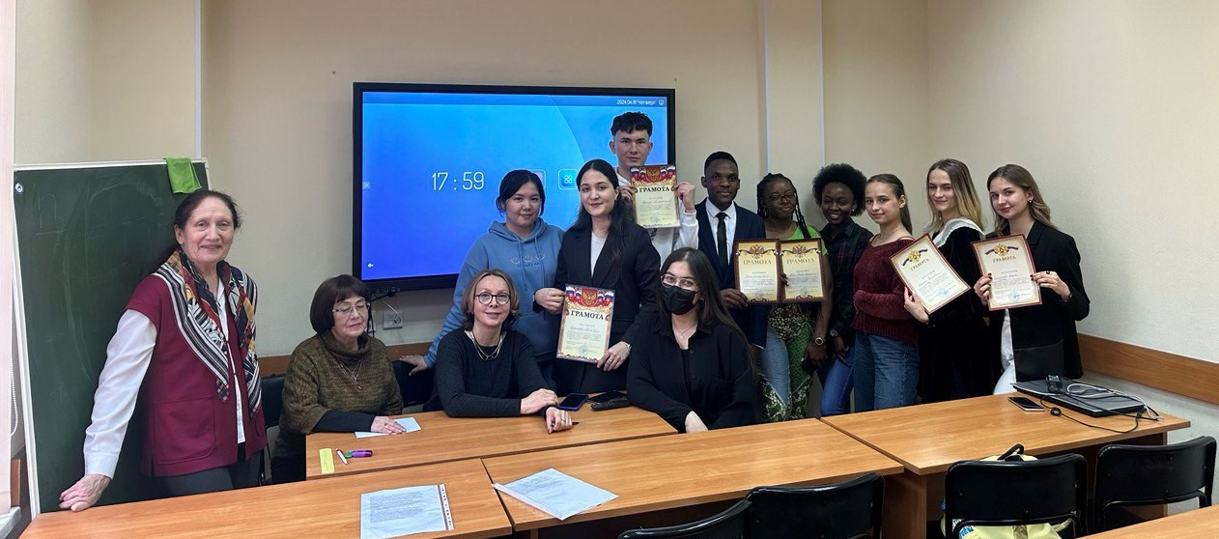
The learning process 学习历程

Slide 20
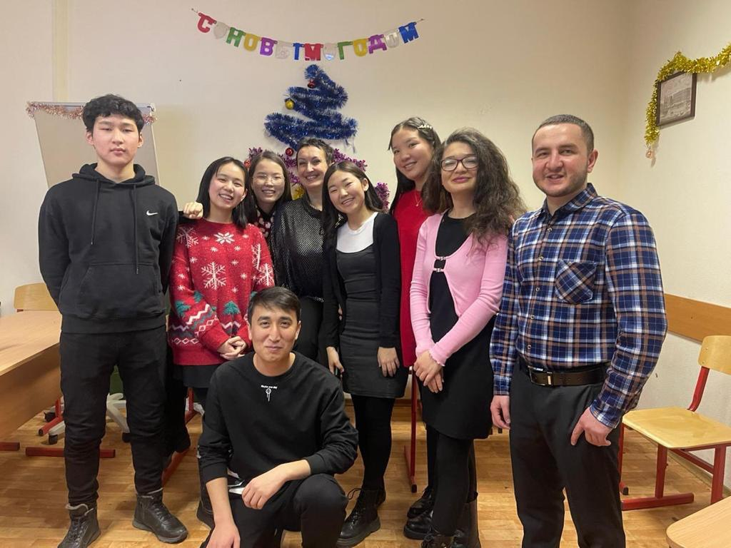
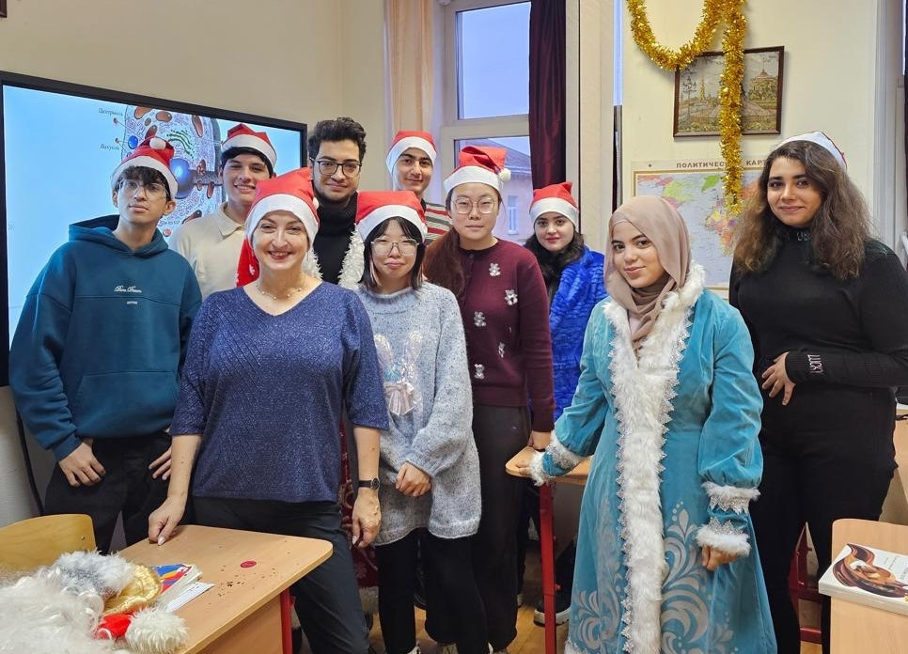
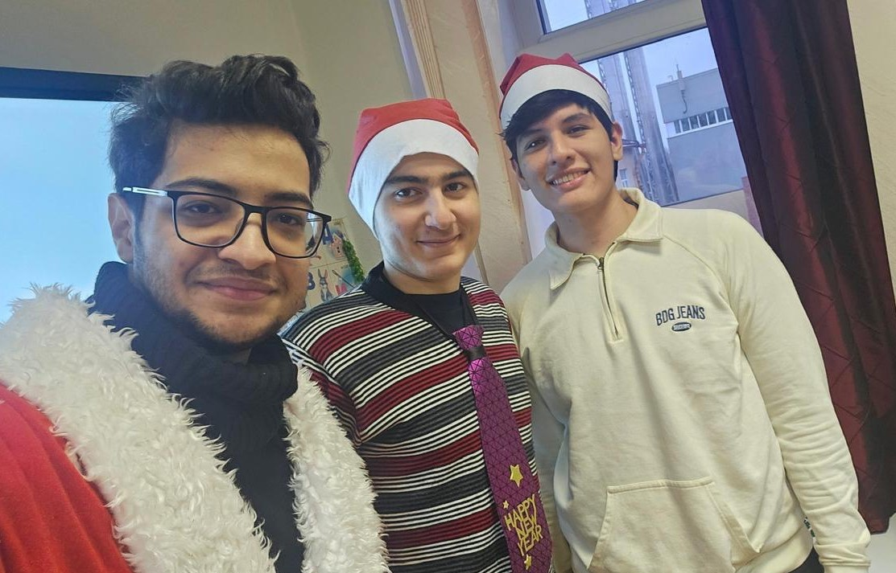
Праздники 假期

